Slide 1
Item Factor Analysis Item Response Theory
Beaujean Chapter 6

Slide 2
A New Issue
What do you do if you have dichotomous (or categorical) manifest variables?
Do you assume the underlying latent variable is continuous?
Do you treat these values as categorical?

Slide 3
A New Issue
Most* agree that more than four response options can be treated as continuous without a loss in power or interpretation.

Slide 4
IFA/IRT
There are two approaches that allow us to analyze data with categorical predictors:
Item Factor Analysis
Item Response Theory

Slide 5
Issues
Unidimensionality
Generally, IFA/IRT is for one-factor analyses
You can split them up to test them or use some new types of analyses to analyze multiple factors
Local Independence
After you control for the latent variable, the items are uncorrelated
Similar idea to MTMM methods.

Slide 6
So which one?
Depends on your goals
IFA
More traditional factor analysis approach
You can talk about item loading, eliminate bad questions, etc.

Slide 7
So which one?
IRT
More tradition test theory approach
You can look at the discriminability, location, and guessing for items.
Additionally, if you use more than two outcomes, you can examine ordering, use of response options, and thresholds

Slide 8
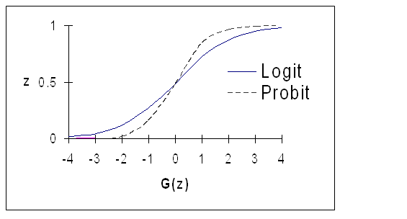
Regression Approach
Both analyses are similar to a log regression
That means that the variable will be transformed
Logit – log regression
Inverse cumulative – probit regression

Slide 9
Item Factor Analysis
The latent variable is assumed to be continuous
Items are treated as “coarse” representations of that variable.

Slide 10
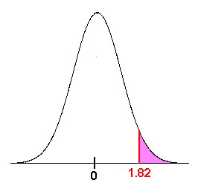
Item Factor Analysis
Threshold – the point at which people get it right
Histogram
The latent variable is on the y-axis

Slide 11
Item Factor Analysis
Tetrachoric correlation
When you have dichotomous items, you end up with a little 2X2 table for the pairwise relationship between items
Correlation between
the diagonals
Item 1 -> Item 2 | Incorrect | Correct
Incorrect | .03 | .05
Correct | .26 | .66

Slide 12
Item Factor Analysis
Limited information method because instead of using the raw data, we transform it to a tetrachoric correlation table first.

Slide 13
Item Factor Analysis
Therefore, you want to use a different estimation method than ML
GLS, ULS, WLS
Best options:
Weighted Least Squares – Means (WLSM)
Weighted Least Squares – Means and Variances (WLSMV)

Slide 14
Item Factor Analysis
Marginal or delta or standardized parameterization
Most models of IFA are underidentified
Identifies by constraining the variance to 1
Most common approach (used by lavaan)

Slide 15
Item Factor Analysis
Conditional or theta and unstandardized parameterization
Identifies by constraining the error variance to 1

Slide 16
Item Factor Analysis
Scaling – same as CFA
Use a marker variable (set one path to 1)
Use latent variable standardization
More common to use LV standardization because it sets the LV mean to 0 and variance to 1
Gives you the loadings and thresholds for items.

Slide 17
Item Response Theory
Traditionally used as a counterpart to classical test theory (CTT) approach
CTT = reliability and item correlation type analysis
CTT says that your score is = True score + error
Cannot separate the test and person characteristics

Slide 18

Item Response Theory
A simple example of test versus person
3 item questionnaire
Yes/no scaling
8 response patterns
Four total scores (0, 1, 2, 3)

Slide 19
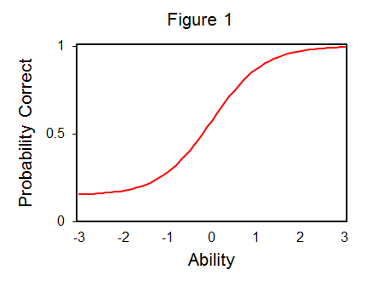
Item Response Theory
Item characteristic curves (ICCs)
The log probability curve of theta and the probability of a correct response

Slide 20
Item Response Theory
Theta – ability or the underlying latent variable score

Slide 21
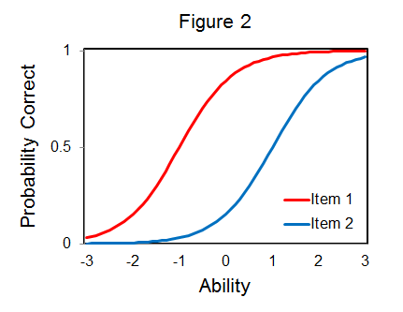
Item Response Theory
b – Item location – where the probability of getting an item correct is 50/50
Also considered where the item performs best
Can be thought of as item difficulty
Larger b = easier questions

Slide 22
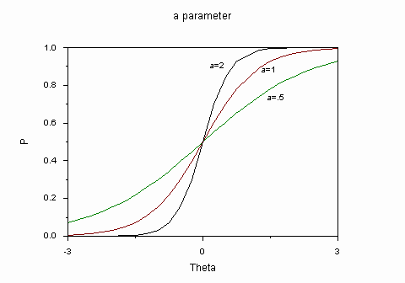
Item Response Theory
a – item discrimination
Tells you how well an item measures the latent variable
Larger a values indicate better items

Slide 23
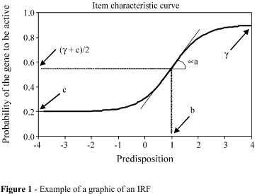
Item Response Theory
c – guessing parameter
The lower level likelihood of getting the item correct

Slide 24
Item Response Theory
1 Parameter Logistic (1PL)
Also known as the Rasch Model
Only uses b
2 Parameter Logistic (2PL)
Uses b and a
3 Parameter Logistic (3PL)
Uses b, a, and c

Slide 25
Item Response Theory
Full information method because it uses the participant response patterns to estimate the parameters.
Most are used with logistic distributions, so they include this D = 1.7 transformation constant

Slide 26
IFA/IRT
IFA and IRT can be converted from one to another.
Generally picked due to theory and goals

Slide 27
Polytomous IRT
A large chunk of IRT focuses on dichotomous data – incorrect/correct or yes/no type answers.
Scoring is easier because you either get it ”right” or “wrong”.
However, a separate set of IRTs focus on polytomous data – or data that are in multiple categories.

Slide 28
Polytomous IRT
These categories are typically ordered – meaning that low scores = low and high scores = high
Likert type scales

Slide 29
Polytomous IRT
Couple of types of models:
Graded Response Model
Generalized Partial Credit Model
Partial Credit Model

Slide 30
Polytomous IRT
A graded response model is simplest but can be hard to fit.
Takes the number of categories – 1 and creates mini 2PLs for each of those boundary points (1-rest, 2-rest, 3-rest, etc.).
You get probabilities of scoring at this level OR higher

Slide 31
Polytomous IRT
The generalized partial credit and partial credit models account for the fact that you may not have each category used equally
Therefore you get the mini 2PLs for adjacent categories (1-2, 2-3, 3-4)
If your categories are ordered (which you often want), these two estimations can be very similar.

Slide 32
Polytomous IRT
Another concern with the partial credit models:
Making sure that all categories have a point at which they are the most likely answer.

Slide 33
Polytomous IRT
Install the mirt() library to use the multidimensional IRT package.
We are not covering multiple dimensional or multigroup IRT, but this package can do those models or polytomous estimation.

Slide 34
IRT Examples
The examples will go over understanding the output and looking at all the pictures.
Specifically,
Looking at the coefficients (b, a, c)
Person and item fit
Factor scores
Item information curves, and item characteristic curves

